Slide 1

Freight Data Warehouse (FXFDW) –
Informatica CDC Code Automation for DB2 to JMS Publishing
June 01, 2021

Slide 2

Contents
Current DB2 to JMS Publishing Process
Process Flow Diagram
Process Flow Description
Informatica PowerCenter Mapping Patterns
Steps to publish data for a new DB2 table to JMS
Challenges with Current DB2 to JMS Publishing Process
Challenges with current process
Solution
Informatica Code Generation Utility
Overview
Prerequisites and Steps
Mapping Overview - mpg_auto_load_DB2_tables_metadata_to_flatfile
Mapping Overview - mpg_auto_generate_InformaticaCode_XSDs
Workflow Overview - wf_mpg_auto_generate_InformaticaCode_XSDs
Importing generated objects
Benefits
Generated Artifacts, Inputs and Outputs
Sample Input and Output
Generated Output - Mapping
Generated Output - Workflows
Generated Output – XSD Files
Generated Output – Parameter Files

Slide 3
Current DB2 to JMS Publishing Process
Process Flow Diagram
JMS
Queue 1
FXFDW
Informatica
Ingestion Jobs
JMS
Queue 2
DB2
Database
Informatica
PowerExchange CDC
Informatica
PowerCenter Mappings
JMS Topic
Bridging Rules
JMS
Queue N
FXFDW
Ab Initio
Ingestion Jobs
Process Flow Description:
Informatica PowerExchange CDC – Create Capture Registration:
For each DB2 table for which data needs to be published, we create a Capture Registration which will enable PowerExchange to read the change data for that table (through DB2 logs) and create an extraction map for the table. This is done manually
Informatica PowerCenter – Create Mapping:
For each DB2 table for which data needs to be published, we create an Informatica Mapping that would extract changed data for the table in conjunction with PowerExchange and publish changed records as JMS messages to a JMS topic. This is done manually
JMS Topic to Queues Bridging Rules:
The published messages are routed from the JMS topics to the queues based on the bridging rules. One time set up required to implement the bridging rules
Read from JMS Queues:
Once the JMS messages are available in the JMS Queues, Informatica and Ab Initio Ingestion jobs read the messages (changes records) and ingest them into the FXF Data warehouse

Slide 4
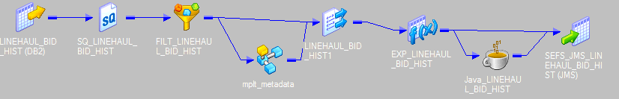
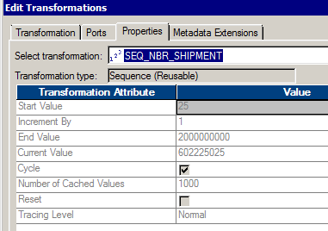
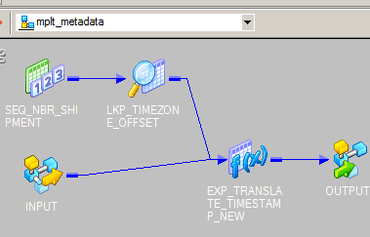
Current DB2 to JMS Publishing Process
Informatica PowerCenter Mapping Patterns
Currently, we have the Informatica Mappings to read changed data from PowerExchange and publish to JMS topics created using 2 patterns:
Pattern 1 - Used in mpg_db2_SEFS_other_to_JMS, mpg_db2_SEFS_ship_to_JMS, mpg_db2_SEFS_ship_base_to_JMS mappings for few tables
Pattern 2 - Used in almost 90% of the JMS mapping pipelines
Pattern 1 - Used in mpg_db2_SEFS_other_to_JMS, mpg_db2_SEFS_ship_to_JMS, mpg_db2_SEFS_ship_base_to_JMS mappings for few tables
This Pattern has a mapplet which involves time zone offset lookup. However, the lookup values are not used in the mapping.
When we lookup at the overall logic, this pattern also will be more or less doing the same as pattern2 without lookup
Using the same reusable sequence (SEQ_NBR)

Slide 5
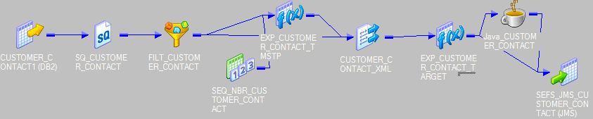
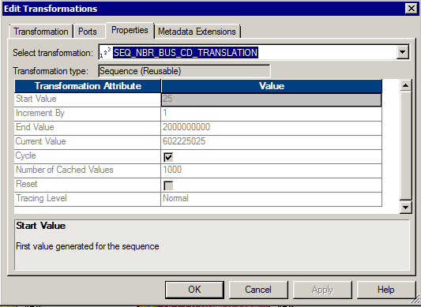
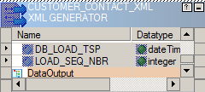
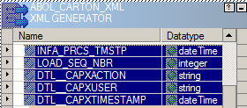
Current DB2 to JMS Publishing Process
Informatica PowerCenter Mapping Patterns (contd …)
Pattern 2 - Used in almost 90% of the JMS mappings
Most of the existing mappings are using this pattern and reusable sequence generator (SEQ_NBR) is used for XML key.
Audit columns in current design
Both patterns have only two columns (DB_LOAD_TSP & LOAD_SEQ_NBR) in the current design
AS per the new requirements , DB_LOAD_TSP need to be renamed as INFA_PRCS_TMSTP and three new columns
DTL__CAPXACTION, DTL__CAPXUSER and DTL__CAPXTIMESTAMP need to be added in all existing mappings
Since this pattern is used for most of the existing tables and is recommended for the new tables with few
additional audit columns, this would be the go forward approach
Existing Design Audit Columns New Design Audit Columns

Slide 6
Current DB2 to JMS Publishing Process
Steps to publish data for a new DB2 table to JMS
Create Informatica PowerExchange Capture Registration
Import Source and Target in Informatica PowerCenter
Import XSD
Create Mapping with Source, Target & transformations.
Create session and workflow instances for all environments ( 7 Workflows for 7 Environments)
Add the Parameter information for all new session instances
Unit Testing and Code migration to higher environments

Slide 7
Challenges with Current DB2 to JMS Publishing Process
Challenges with current process
Mappings, Sessions and Workflows need to be created manually for each new table.
With the requirement to publish DB2 data for 300 new tables (and many more to come in future), this will become a massive manual effort.
Considering manual effort of creating the mapping is around 2-3 hours for each table, the total effort would be 900 man hours with the current approach!
Any changes in the design for existing mappings like adding or removing Audit columns, logic changes, etc will be expensive.
Creating/modifying the parameter files for newly added tables is expensive
XSD structures specifying the structure of published JMS messages need to be created/modified manually for all new or updated DB2 tables
Multiple Workflow instances for all 7 environments(L1 through L6 and PROD) need to be created manually
Solution
Create an automated Code Generation Utility using Informatica that would automatically create that following artifacts based on provided configuration information:
Create the required Informatica Mapping that would extract changed data for the table in conjunction with PowerExchange and publish changed records as JMS messages to a JMS topic.
Create the required Sessions and Workflows
Create the required XSD structures that specify the structure of published JMS messages

Slide 8
Informatica Code Generation Utility
Overview
The Code Generation Utility would create the Informatica Mapping that would extract changed data for a table in conjunction with PowerExchange and publish changed records as JMS messages to a JMS topic
The created mapping will have predefined components to perform data extraction and publishing .
Will need minimal development effort. All we need is to add the list of tables in a file and run the utility.
Most of the manual time consuming development process is automated. The only manual activities would be some post automation activities like place the code (mappings) in the repository.
With this automation approach, irrespective of the number of source tables, whole development of Informatica code (mappings) can be completed in just one hour as compared to the current approach which might take up to approximately 900 hours for 300 tables
The Code Generation Utility will create mappings based on the Mapping Pattern 2 that was detailed in previous slides
Code generation utility is available in PWX_DEV_AUTOMATION folder with all necessary objects involved in the entire automation process. The utility has 2 main mappings:
Mapping 1 : mpg_auto_load_DB2_tables_metadata_to_flatfile
Mapping 2 : mpg_auto_generate_InformaticaCode_XSDs

Slide 9
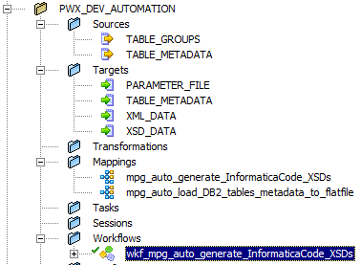
Informatica Code Generation Utility
Prerequisites and Steps
Code automation utility is available in PWX_DEV_AUTOMATION folder with all necessary objects involved in the
entire automation process
Prerequisites for running the Code Generation Utility
Ensure that all the required DB2 tables are available in database and CDC capture registrations are completed for them
Ensure that the Topics/ Queues are available and accepting data while validating the code
Ensure that the CDC Flag is enabled for all DB2 tables for which changed data needs to be published
Backup the existing automation output file XML_DATA.XML if needed
High level steps for running the Code Generation Utility
Make an entry of these tables into infa_workflow_gen_cdc.txt file in /opt/informatica/shares/tmp_ifa/SharedJobs/SrcFiles/
PWX_DEV_AUTOMATION/INPUT location
Set the automation parameters into infa_workflow_gen_cdc.prm in /opt/informatica/shares/tmp_ifa/SharedJobs/SrcFiles/PWX_DEV_AUTOMATION/PRM location
Run wf_mpg_auto_generate_InformaticaCode_XSDs Workflow available in PWX_DEV_AUTOMATION folder in L2 repository
Copy the auto generated XML code file from /opt/informatica/shares/tmp_ifa/SharedJobs/SrcFile/PWX_DEV_AUTOMATION
Process all steps described in Import Procedure

Slide 10

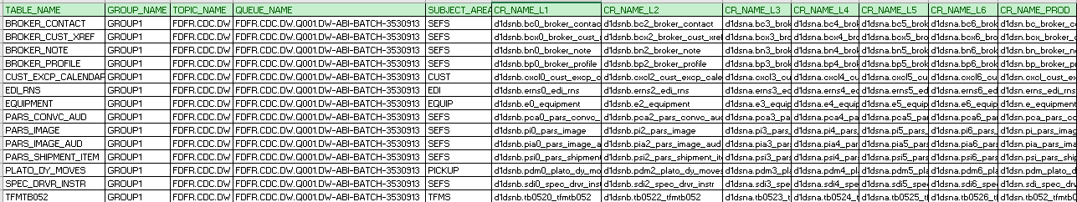
Informatica Code Generation Utility
Mapping Overview - mpg_auto_load_DB2_tables_metadata_to_flatfile
Mapping 1 : mpg_auto_load_DB2_tables_metadata_to_flatfile
Input File
Parameter Controls
Parameter File Name : $PMSourceFileDir\PWX_DEV_AUTOMATION\PRM\infa_workflow_gen_cdc.prm
$InputFileTABLE_GROUPS - Name of the Input File as defined in Paramter file
$OutputFileTABLE_METADATA - Name of the Output File as defined in parameter file (Input for Session2)

Slide 11
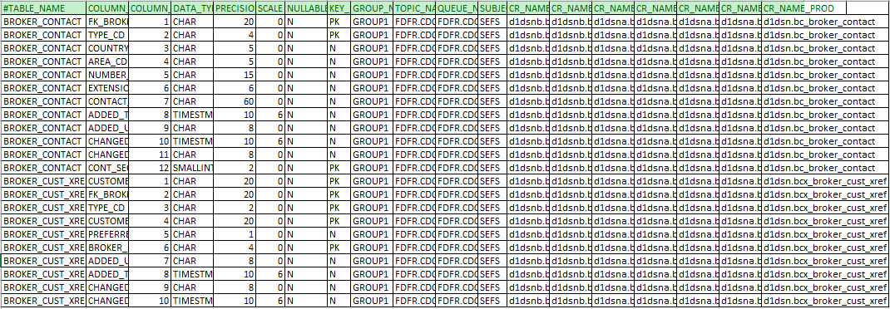
Informatica Code Generation Utility
Mapping Overview - mpg_auto_load_DB2_tables_metadata_to_flatfile
Output File

Slide 12
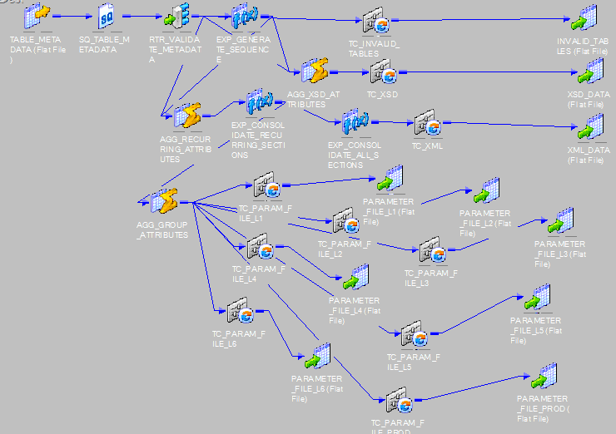
Informatica Code Generation Utility
Mapping Overview - mpg_auto_generate_InformaticaCode_XSDs
Mapping 2 : mpg_auto_generate_InformaticaCode_XSDs

Slide 13
Informatica Code Generation Utility
Mapping Overview - mpg_auto_generate_InformaticaCode_XSDs
Input and Parameter Files for Code Generation Utility Output File for XSD Targets ( Each table) Output Files for Parameters (Each Environment)
Output File for Automation Code (Each Group)
Parameter Controls
$InputFileTABLE_METADATA – Name of the Input file as defined in parameter file (Output of Session1)
$$MAPPING_PREFIX – Mapping name prefix for all mappings created with this automation procedure
$$WF_PARAMETER_FILE -- Workflow Parameter File Name which need to be used for all workflows
$$XML_FILE_NAME – Code generation file prefix name (Appended with system timestamp to avoid overwriting of older files)
$$FOLDER_NAME -- Default registered Folder Name of the code
$$TARGET_NAME -- JMS Target Name which needs to be created
$$ENVIRONMENT1 to $$ENVIRONMENT7 -- Environment Names for which the workflow copies are created
$$AppConnectionSource – DB2 Source connection prefix name (suffixed with _Environment name) -- Make sure this connection already exists with all environments (L1 – L6,PROD)
$$AppConnectionTarget-- JMS Target connection prefix name (suffixed with _Environment name) ) -- Make sure this connection already exists with all environments (L1 – L6,PROD)
$$AppConnectionJNDI--JNDI connection for target -- Make sure this connection already exists
$$ ParamTargetSchema_E1 to $$ ParamTargetSchema_E7 -- Target Schena names for respective environments
$$OutputFileINVALID_TABLES– Invalid tables list file loaded with non existing tables in the referenced database
Here <$$XML_FILE_NAME> _<GROUP_NAME>_<TIMESTAMP>.XML is the Informatica Code generated file for respective group which will further need to be used to import the corresponding mappings, sessions & workflows.
XSD_DATA file will be generating the XSD structure for each table in the required location. The mappings are created based on Input grouping and will have a separate mapping
(mpg_ $$MAPPING_PREFIX _GROUPNAME) for each group with corresponding table pipelines.

Slide 14
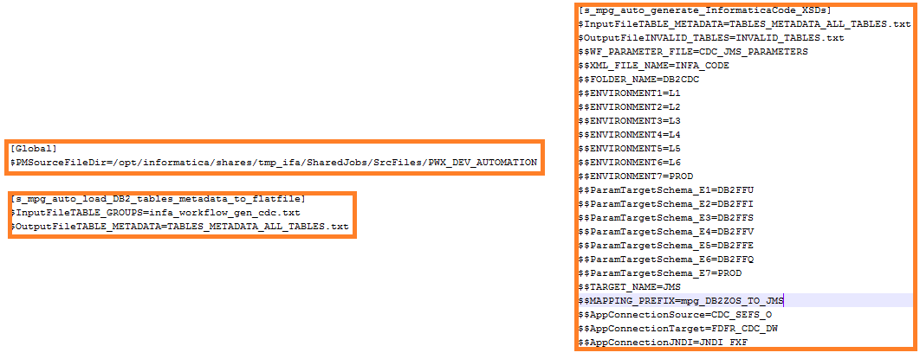
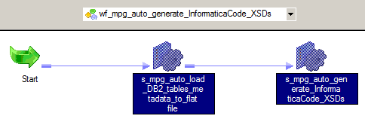
Informatica Code Generation Utility
Workflow Overview - wf_mpg_auto_generate_InformaticaCode_XSDs
There are two sessions manages overall code generation Utility process and will write the code into XML file with corresponding XSD files for all targets and parameter files for all environments.
Parameter File Controls

Slide 15
Informatica Code Generation Utility
Importing generated objects
Import Procedure to replicate the objects from XML file
Copy the XML files named <$$XML_FILE_NAME>_<GROUP_NAME>_YYYYMMDDHH24MISS.XML parameter from Shared drive (/opt/informatica/shares/tmp_ifa/SharedJobs/SrcFiles/PWX_DEV_AUTOMATIO/CODE) into local drive
Pick each Group Code XML file and repeat below steps for each file.
Open the Repository Manager tool and connect to the required folder in the repository and ensure the user have write privileges to import
Select Repository -> Import Objects and choose the copied XML file and click next to see all available Informatica Objects (Sources, Targets, Reusable Transformations, Sessions, Workflows) and proceed with next step
Select and add the Informatica objects which need to be imported and proceed with next step
Choose the destination folder where the code need to be migrated and proceed with next step
Enable Check-in option and give comments for code import and proceed with next step
Skip the Rules step and proceed with next step
Resolve all the conflicts with Rename/Replace/Skip option and proceed with next step
Click on Finish to start the Import and ensure all the selected objects are imported and checked in without any issues
Validation of Imported Objects
Open the Designer and connect to the designated folder and ensure the imported objects are valid
Open the Workflow Manager and connect to the designated folder and ensure the imported objects are valid
Run and test the workflows randomly to ensure there are no issues

Slide 16
Informatica Code Generation Utility
Benefits
Code development effort is drastically reduced and stays the same (Less than an hour) for any number of new tables whether it is one or many as compared to the current approach that needs up to 2 hours for each mapping
The utility can handle customizations in the existing design as needed
Any future enhancements like adding/removing auditing columns or any functionality changes in the design or table structure changes would be simple to implement provided the team owning this utility gets a good understanding of the utility code and what necessary changes are needed to regenerate the code and overwrite them
With the input file taking a list of tables for code generation and parameter files controlling the most common dynamic elements like Folder Name, Connections, Mapping Name, Target Name, etc., this Utility provides an easy/convenient way to manage changes
XSD files to specify JMS message structure for each table is created automatically (Manual effort is avoided)
Parameter file is automatically updated with necessary parameters (Manual effort is avoided)

Slide 17



Generated Artifacts, Inputs and Outputs
Sample Input and Output
One mapping and session is created for each group based on the number of tables being included with 7 workflows for each session as displayed below
Input Parameters and default values
$$MAPPING_PREFIX → mpg_DB2ZOS_TO_JMS
$$WF_PARAMETER_FILE → CDC_JMS_PARAMETERS
$$FOLDER_NAME → DB2CDC
$$TARGET_NAME → JMS
$$ENVIRONMENT1 → L1 $$ENVIRONMENT2 → L2 ……… $$ENVIRONMENT6 → L6 $$ENVIRONMENT7 → PROD
Input File and grouping options
As shown above if there are three tables supplied with AF_CALENDAR, EQUIPMENT under GROUP1 and TFMTB051 under GROUP2, Automation will be creating the XML with two mappings as mpg_DB2ZOS_TO_JMS_GROUP1 with two pipelines and mpg_DB2ZOS_TO_JMS_GROUP2 with one pipeline
Sources, Target, User Defined Functions & Reusable Transformations
TABLE_NAME | GROUP_NAME
AF_CALENDAR | GROUP1
EQUIPMENT | GROUP1
TFMTB051 | GROUP2

Slide 18
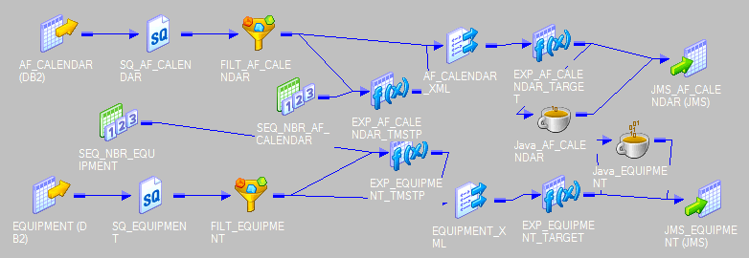
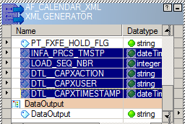
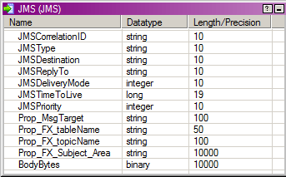
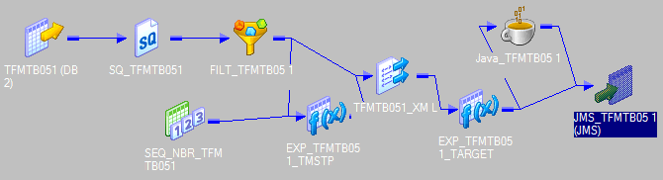
Generated Artifacts, Inputs and Outputs
Generated Output - Mapping
Mapping Pattern, JMS Target and Audit Columns
mpg_DB2ZOS_TO_JMS_GROUP1 Audit Columns XSD Files
JMS Target and Header Information Parameter File
mpg_DB2ZOS_TO_JMS_GROUP2

Slide 19

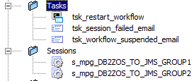
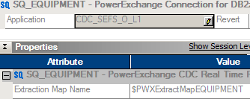
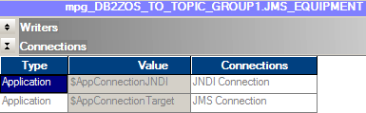
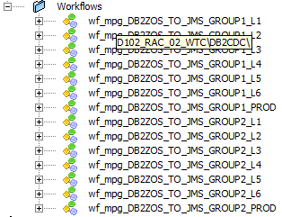

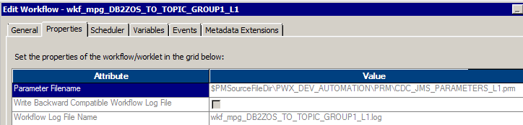
Generated Artifacts, Inputs and Outputs
Generated Output - Workflows
Reusable Sessions & Tasks
Workflows with copies for all environments

Slide 20
Generated Artifacts, Inputs and Outputs
Generated Output – Workflows (contd …)
Workflow Scheduling
Currently all the workflows created/imported are not scheduled and will run only when it is executed manually. However, if we want the workflows to run continuously or scheduled, the automation code can be enhanced to include the schedule as needed.
Parameter Files
All the Parameter files creation is automated. This process creates one separate parameter file for each environment.
Naming Conventions for Informatica Objects
Workflow Name → wkf_<Mapping Name>_<$$ENVIRONMENT No>
Session Name → s_<Mapping Name>_<$$ENVIRONMENT No>
Mapping Name → <$$MAPPING_PREFIX>_<GROUP_NAME>
Source Name → <TABLE_NAME>
JMS Target Name → <$$TARGET_NAME>
Parameter File Name → < $$WF_PARAMETER_FILE>_ <$$ENVIRONMENT No>.prm
Informatica CodeFile → $$XML_FILE_NAME_<GROUP_NAME>_YYYYMMDDHH24MISS.XML
XSDFile → <TARGET_NAME>.xsd

Slide 21
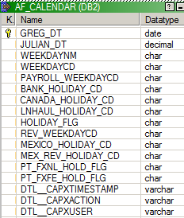
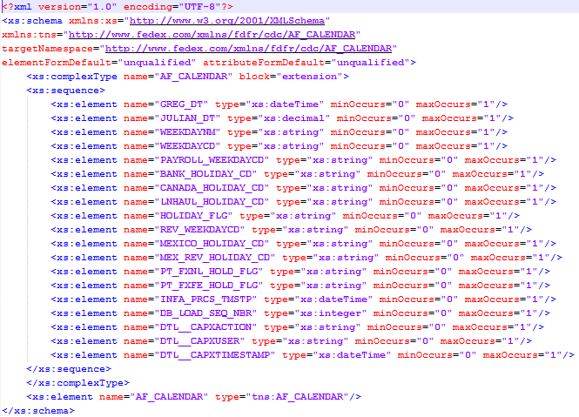
Generated Artifacts, Inputs and Outputs
Generated Output – XSD Files
For every table to be published, a new XSD file is created in opt/informatica/shares/tmp_ifa/SharedJobs/TgtFiles/ folder with all columns of input table along with Audit columns
DB2 Source Table (ABOL_CARTON_SCAN) Output XSD File(AF_CALENDAR.XSD)

Slide 22
Generated Artifacts, Inputs and Outputs
Generated Output – Parameter Files
For every environment, there will be separate Parameter file generated for each environment as follows.
CDC_JMS_PARAMETERS_L1.prm : This file will be used as parameter file for all L1 workflows with sources pointed to CDC_SEFS_O_L1(DB2) of CR_NAME_L1 registration names and targets pointed to FDFR_CDC_DW_L1(JMS) connections
CDC_JMS_PARAMETERS_L2.prm : This file will be used as parameter file for all L2 workflows with sources pointed to CDC_SEFS_O_L2(DB2) of CR_NAME_L2 registration names and targets pointed to FDFR_CDC_DW_L2(JMS) connections
CDC_JMS_PARAMETERS_L3.prm : This file will be used as parameter file for all L3 workflows with sources pointed to CDC_SEFS_O_L3(DB2) of CR_NAME_L3 registration names and targets pointed to FDFR_CDC_DW_L3(JMS) connections
CDC_JMS_PARAMETERS_L5.prm : This file will be used as parameter file for all L5 workflows with sources pointed to CDC_SEFS_O_L5(DB2) of CR_NAME_L5 registration names and targets pointed to FDFR_CDC_DW_L5(JMS) connections
CDC_JMS_PARAMETERS_L6.prm : This file will be used as parameter file for all L6 workflows with sources pointed to CDC_SEFS_O_PROD(DB2) of CR_NAME_PROD registration names and targets pointed to FDFR_CDC_DW_L6(JMS) connections. Here the Source connections are pointed to PROD as we need to test the L6 JMS Load with Prod source data
CDC_JMS_PARAMETERS_L4.prm : This file will be used as parameter file for all L4 workflows with sources pointed to CDC_SEFS_O_PROD (DB2) of CR_NAME_PROD registration names and targets pointed to FDFR_CDC_DW_L4_(01-05) (JMS) connections where the JMS connections are varied from 01 to 05 depending on the Queue/GROUP number as follows
GROUP1, GROUP11 will be processed into Q001 and GROUP2, GROUP12 will be processed into Q002 which uses FDFR_CDC_DW_L4_01 connections pointed to Instance/Server 01
GROUP3, GROUP13 will be processed into Q003 and GROUP4, GROUP14 will be processed into Q004 which uses FDFR_CDC_DW_L4_02 connections pointed to Instance/Server 02
GROUP5, GROUP15 will be processed into Q005 and GROUP6, GROUP16 will be processed into Q006 which uses FDFR_CDC_DW_L4_03 connections pointed to Instance/Server 03
GROUP7, GROUP17 will be processed into Q007 and GROUP8, GROUP18 will be processed into Q008 which uses FDFR_CDC_DW_L4_04 connections pointed to Instance/Server 04
GROUP9, GROUP19 will be processed into Q009 and GROUP10, GROUP20 will be processed into Q010 which uses FDFR_CDC_DW_L4_05 connections pointed to Instance/Server 05
CDC_JMS_PARAMETERS_PROD.prm : This file will be used as parameter file for all L4 workflows with sources pointed to CDC_SEFS_O_PROD (DB2) of CR_NAME_PROD registration names and targets pointed to FDFR_CDC_DW_PROD_(01-05) (JMS) connections where the JMS connections are varied from 01 to 05 depending on the Queue/GROUP number as follows
GROUP1, GROUP11 will be processed into Q001 and GROUP2, GROUP12 will be processed into Q002 which uses FDFR_CDC_DW_PROD_01 connections pointed to Instance/Server 01
GROUP3, GROUP13 will be processed into Q003 and GROUP4, GROUP14 will be processed into Q004 which uses FDFR_CDC_DW_PROD_02 connections pointed to Instance/Server 02
GROUP5, GROUP15 will be processed into Q005 and GROUP6, GROUP16 will be processed into Q006 which uses FDFR_CDC_DW_PROD_03 connections pointed to Instance/Server 03
GROUP7, GROUP17 will be processed into Q007 and GROUP8, GROUP18 will be processed into Q008 which uses FDFR_CDC_DW_PROD_04 connections pointed to Instance/Server 04
GROUP9, GROUP19 will be processed into Q009 and GROUP10, GROUP20 will be processed into Q010 which uses FDFR_CDC_DW_PROD_05 connections pointed to Instance/Server 05

Slide 23
Thank You

